Slide 1

Git Basics
WA200 – Web Application Design and development

Slide 2
What is Git?
Git is a version control system for tracking changes in computer files and coordinating work on those files among multiple people.
It is primarily used for source code management in software development, but it can be used to keep track of changes in any set of files. As a distributed revision control system it is aimed at speed, data integrity, and support for distributed, non-linear workflows.

Slide 3


GIT vs GitHub.com
VS.
Git is a version control system that takes snapshots of your code at certain points in development.
These snapshots are stored in a ‘repo’, or repository on your local machine.
GitHub.com is a website that can host your repositories on a remote server.

Slide 4
Getting Setup
If you don’t already have it, you can download git at: http://git-scm.com/downloads
If you are a Windows user, use Git Bash (included with Git) for all terminal and git interactions. Or during setup, configure Git to work with the standard Windows command line window.
To check if you have Git and what version you are using, type git --version at the command prompt.

Slide 5
Why Learn Git?
Git allows you to see the changes you make to your code and easily revert those changes if needed.
It easily allows you to push your git repositories to GitHub
You will eventually push code to a remote server (most likely using git – your application’s host) so you can release your webpage or application to the world.

Slide 6
Configuring Git
Your commits will have your name and e-mail attached to them. Before you put anything up publicly, make sure they are configured and correct!
> git config --global user.name “Your Name”
TO CHECK: git config user.name > should return your username
> git config --global user.email “you@email.com”
TO CHECK: git config user.email
> should return your e-mail

Slide 7
Getting Started
Before using git, you need a project to use it with.
We consider a “project” any directory (folder) full of files - this could be a website, web application or really any collection of files.
Use the cd command to navigate to the directory that you want to use git in.

Slide 8
Getting Started: git init
Once you are in your project’s directory, run the initialize command to get started.
> git init
You only need to run this command ONCE per project
If you are not sure if you have initialized a project yet. Try running the git status command. If you get a fatal error, you haven’t run git init yet.

Slide 9
Making Your First ‘Commit’
A commit is a snapshot of your project at a certain time.
It tracks all of the changes you’ve made since the last commit.
There are two steps to making the commit:
stage your files: choose which files you are committing
commit: tell git to make your commit with an accompanying descriptive message.

Slide 10
Staging Files
To stage an individual file, use the command: git add
To stage every file/change since your last commit, just use the command followed by -A
> git add index.html
> git add -A

Slide 11
Making the Commit
Only after your files are staged can you make a commit by using the git commit command.
It’s always good practice to also include the -m flag so that you can add a descriptive message to your commit. (“Initial commit” is standard as the message for your very first commit on an project)
> git commit -m “Initial commit”
> git commit -m “Updated CSS”

Slide 12

Pro Tip: You Need Files!
A common mistake is to get so excited about starting your new project that you try to run git init before you even have any files to initialize.
Git won’t work unless you have files to track!

Slide 13
Command: git status
You can always run this command “for free”, meaning it has no real repercussions.
This can help you figure out if:
git is initialized for this project
what files have been staged
what files have been changed since the last commit

Slide 14
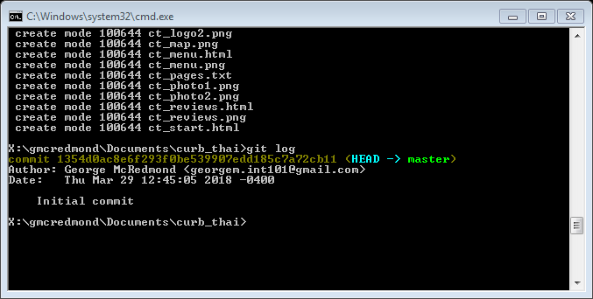
Command: git log
If you are curious about what commits have been made so far, git log will show you documentation on the commit history.

Slide 15
Exercise: Getting to Know Git
Create a new project folder with at least two files (like an index.html and styles.css)
Initialize a new git repository in this folder
Make your initial commit
Go and make a change to one or both files, then make a new commit
Run a log to see your changes

Slide 16

SSH & GitHuB
WA200 – Web Application Design and development

Slide 17
What is SSH?
SSH is a pseudo-acronym that stands for “Secure Shell”.
This technology provides a protocol for secure communication between a client (your computer) and a remote server.
Authentication works through the exchange of keys, which are simply files.
A public key given out to trusted servers.
A private key that lives on your machine to verify the public key against.

Slide 18
Why Use SSH?
You’ll be able to communicate securely with servers around the world.
Passwords won’t be necessary for secure communication between your computer and any other computer if you use SSH.
It does save a lot of time of your development career!

Slide 19
Git Bash
Git Bash comes when you install git and is a package containing bash (a command line shell) as well as other utilities.
Since many of the SSH commands were written with Terminal in mind (Mac and Linux), Git Bash needs to be used as opposed to just simply using Command Line.

Slide 20
Using SSH
In order to use SSH, you’ll need to generate a public and private key pair.
This pair is almost always stored in the ~/.ssh directory which is a directory that will only exist if you have created SSH keys before.
Before going through the key creation process, you should check to see if you already have a key pair (if you do have keys, you can skip to the final step).
$ cd ~/.ssh
$ ls
# If you get anything back that ends in
‘.pub’, you might have keys already!

Slide 21
Creating Your Keys
Assuming you don’t already have a set of keys, use these commands to generate them:
Press ENTER and it should then prompt with:
Simply press ENTER here to save in the default folder for SSH keys.
$ ssh-keygen -t rsa -b 4096 -C “youremail@example.com”
Enter file in which to save the key (/Users/username/.ssh/id_rsa):

Slide 22
Creating Your Keys (continued)
You will then be prompted to enter a passphrase (password) and then to re-enter it a 2nd time.
Pressing ENTER will proceed with NO passphrase (not recommended).
No return will appear while you type the passphrase so be careful!
Assuming all goes well, you’ll see a message saying that your keys have been saved.

Slide 23
Adding Your New Key
SSH-agent is the go-between program that send keys. You need to make it aware of your new set of keys.
# Start the ssh-agent in the background
$ eval “$(ssh-agent -s)”
# Agent pid 12345
#Now add your key
$ ssh-add ~/.ssh/id_rsa

Slide 24
Final Steps: Copy Your Key
Now that you’ve generated and stored your SSH keys, you’ll need to copy the public key. Use the command:
Note: This assumes that you kept the default name and folder (from Slide 21).
$ clip < ~/.ssh/id_rsa.pub

Slide 25
Final Steps: Adding Keys To Your Accounts
To add your copied key to GitHub, log in to your account. Then go to Settings -> SSH and GPG Keys -> New SSH Key.
Paste what should be on your clipboard into the text area, then click the “Add Key” button. (You can have multiple keys for various computers).
Now you can utilize the SSH URL of any GitHub repository instead of the HTTPS url, which will avoid the necessity of entering your password each time you clone a repo.

Slide 26
Exercise: Use git to Add Files to a GitHub Repo
Create a new git repository locally (or use the one from the previous session) and then create a new repository also on GitHub.com.
When creating your GitHub repo, it is easier to NOT initialize the new repo with a readMe file if you plan on using Git commands to upload your work (it will then just create more or less a “placeholder” for you that you will control with Git).

Slide 27
Exercise: Use git to Add Files to a GitHub Repo
Copy the line of code provided by GitHub where is says “or push an existing repository from the command line..” git remote add origin git@github.com:yourname/yourrepo.git
Make sure you can successfully push to that repository git push -u origin master

